Slide 1

AGENT STUDIO
Turn Any Enterprise Data Into Intelligent AI Agents — In Minutes, Not Months
PRODUCT OVERVIEW & ARCHITECTURE

Slide 2
OUR ROOTS
Born at IIT Hyderabad.
Every category has a moment when deep research meets real-world urgency. For enterprise AI agents, that moment is happening at IIT Hyderabad. Actoryx was founded from within one of India's most rigorous engineering institutions, with IIT professors shaping the platform's architecture from day one — not as advisors on the sidelines, but as builders in the room. That pedigree shows up in the product: Agent Studio treats connector design, code generation, and multi-agent orchestration as engineering problems worth solving properly, not features to ship fast and fix later. This is what happens when a research institution builds for production.
ACTORYX AGENT STUDIO
02

Slide 3
WHAT WE'LL COVER
THE PLATFORM
HOW IT WORKS
ENTERPRISE & SCALE
01 Hero Architecture
04 Agent Lifecycle — Connect to Interact
06 Enterprise Features
02 Platform Layers
05 Generated Outputs
07 Multi-Agent Orchestration
03 Supported Connectors
08 Deployment Architecture
UNDER THE HOOD
WHY ACTORYX
SEE IT IN ACTION
09 Code Generation — Python & Java
10 How We Compare
12 Salesforce & MongoDB, side by side
11 Complete Architecture at a Glance
ACTORYX AGENT STUDIO
03

Slide 4
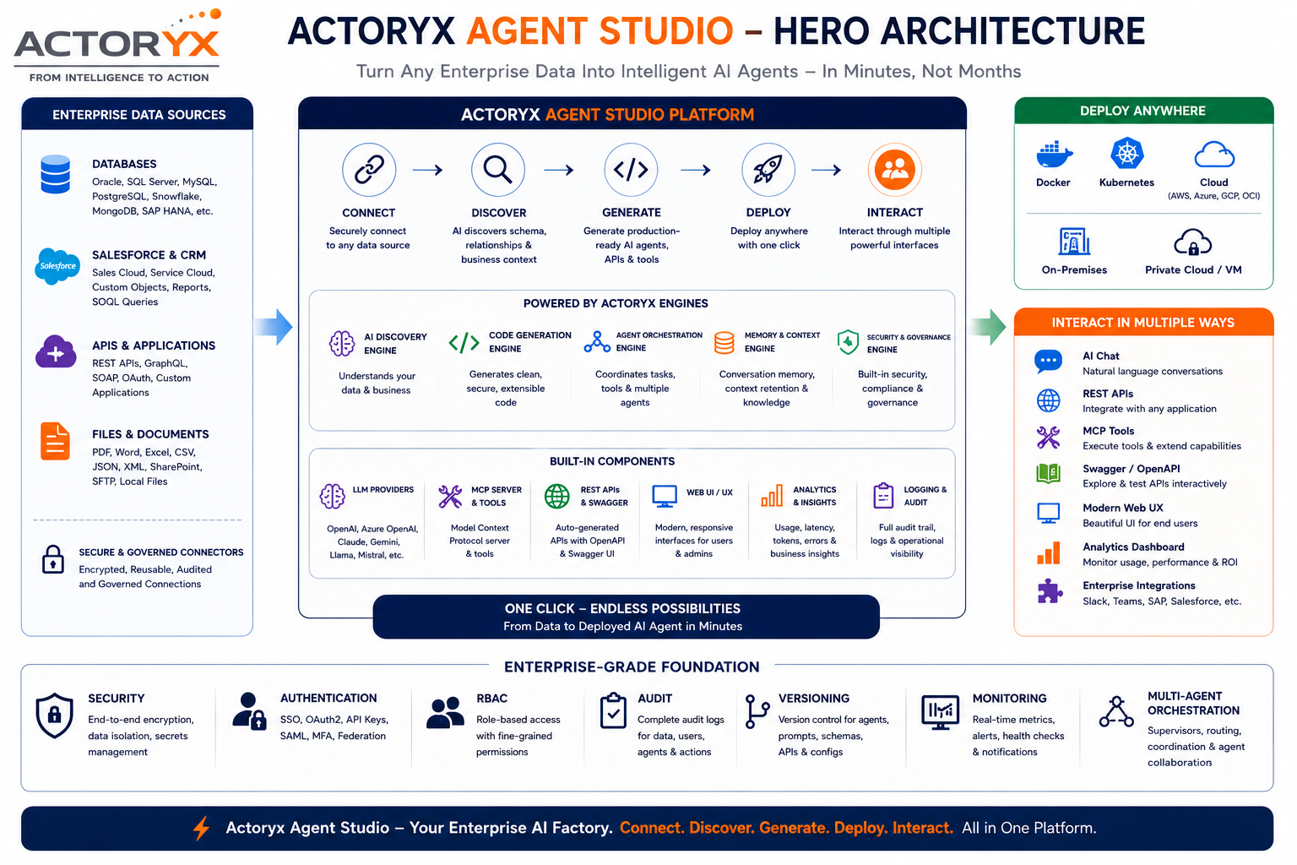
04

Slide 5
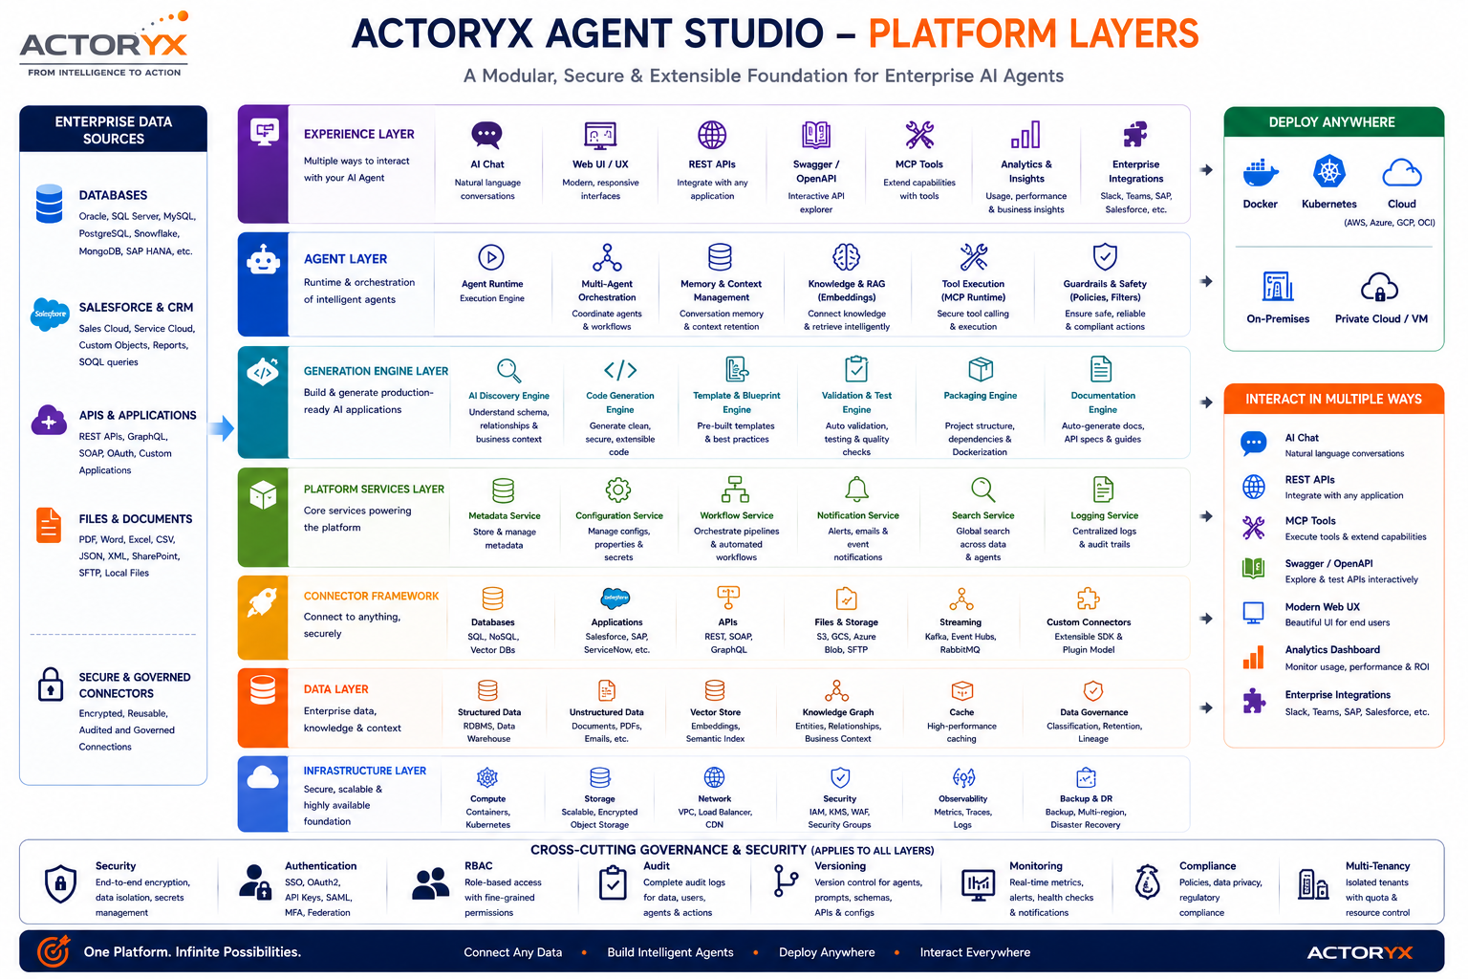
05

Slide 6
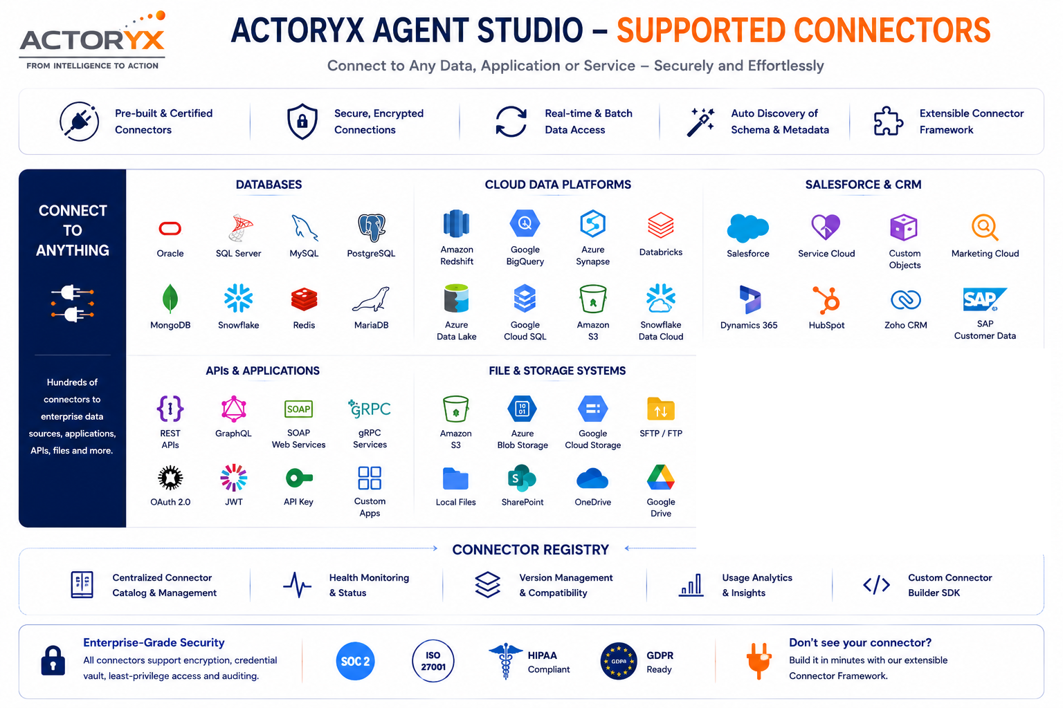
ENTERPRISE SYSTEMS
WORK IN PROGRESS
SAP ERP
SAP S/4HANA
Oracle E-Business Suite
Workday
Not yet available — on our roadmap.
06

Slide 7
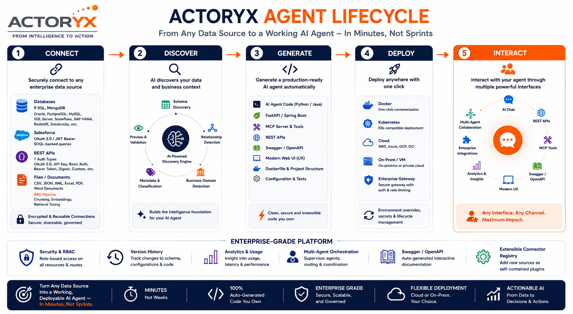

Slide 8
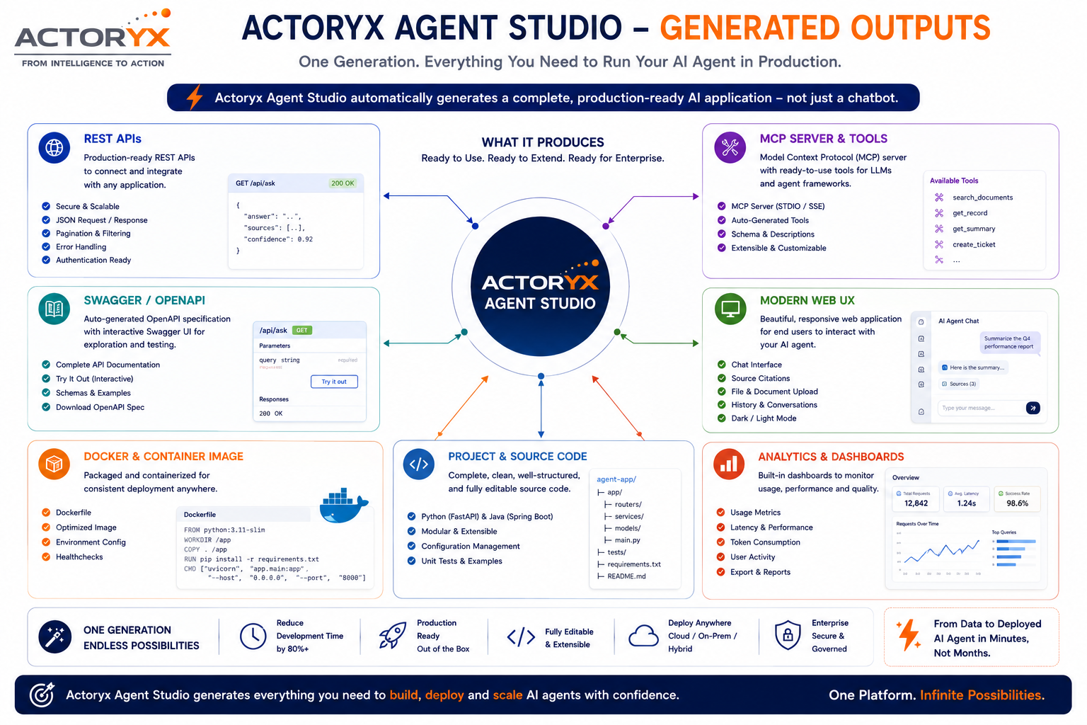
08

Slide 9
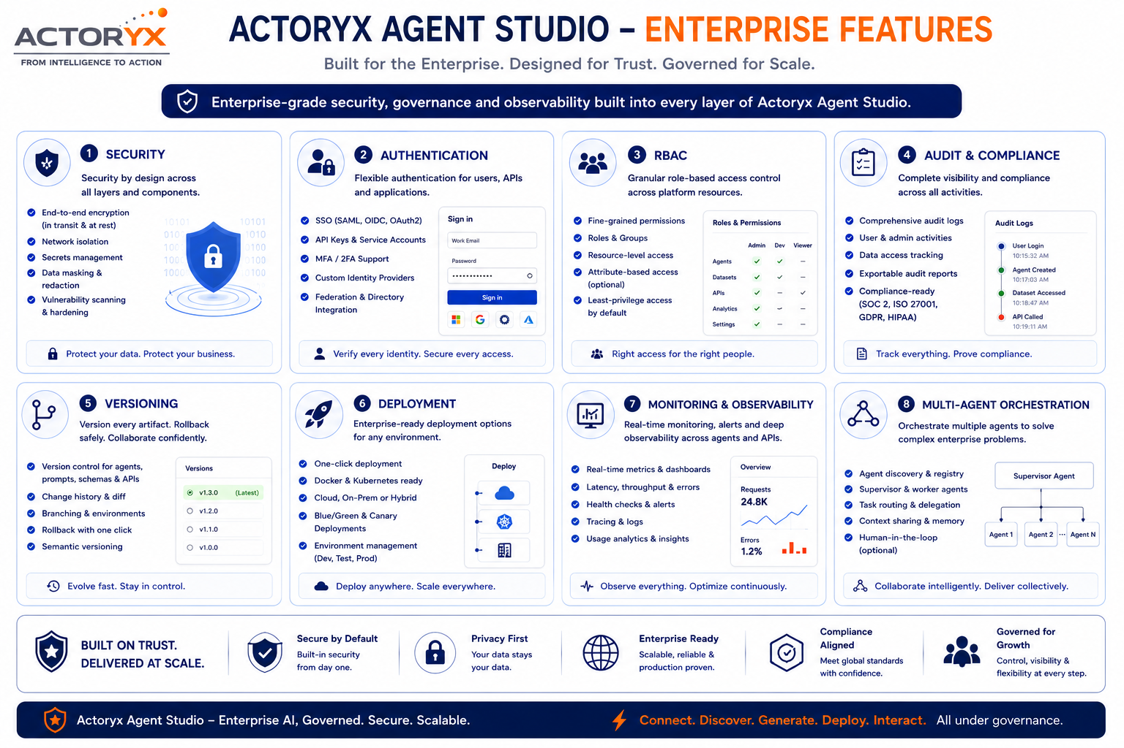
09

Slide 10
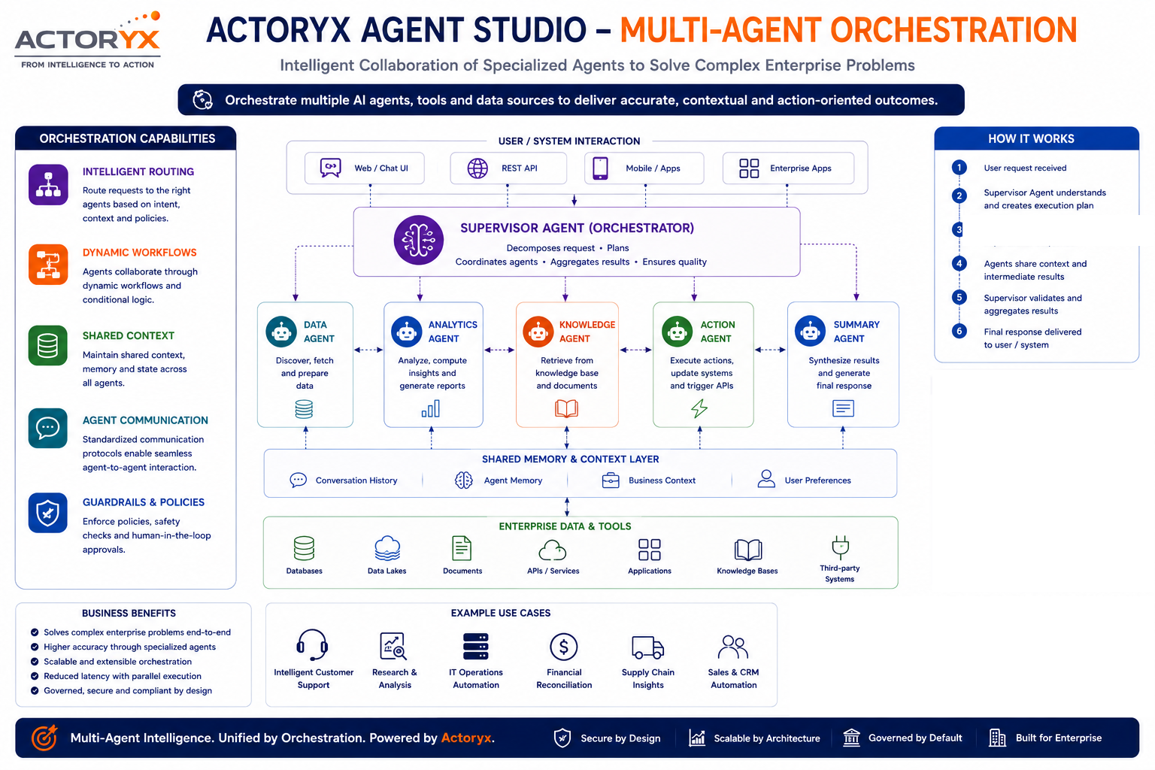
Matched specialist replies
using its own tools
ORCHESTRATION PATTERNS
SHIPPED
Hierarchical routing
Coordinator + one specialist per selected object, matched by keyword.
ON THE ROADMAP
Sequential · Parallel · Event-Driven · Human-in-the-Loop
Not yet available.
HOW ROUTING WORKS
1 KEYWORD
SUBSTRING
FALLBACK
per specialist
case-insensitive
Coordinator handles the rest
10

Slide 11
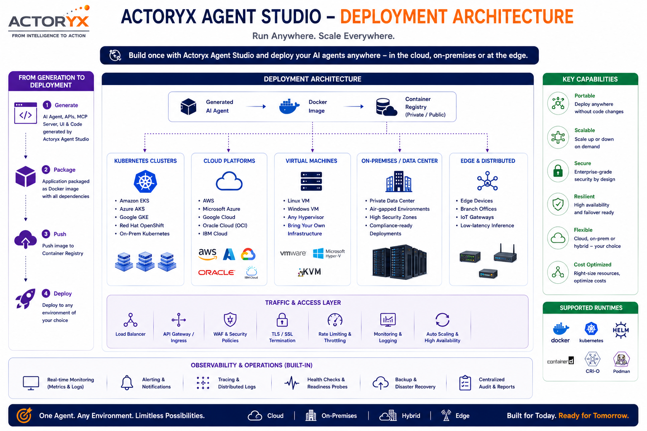
11

Slide 12
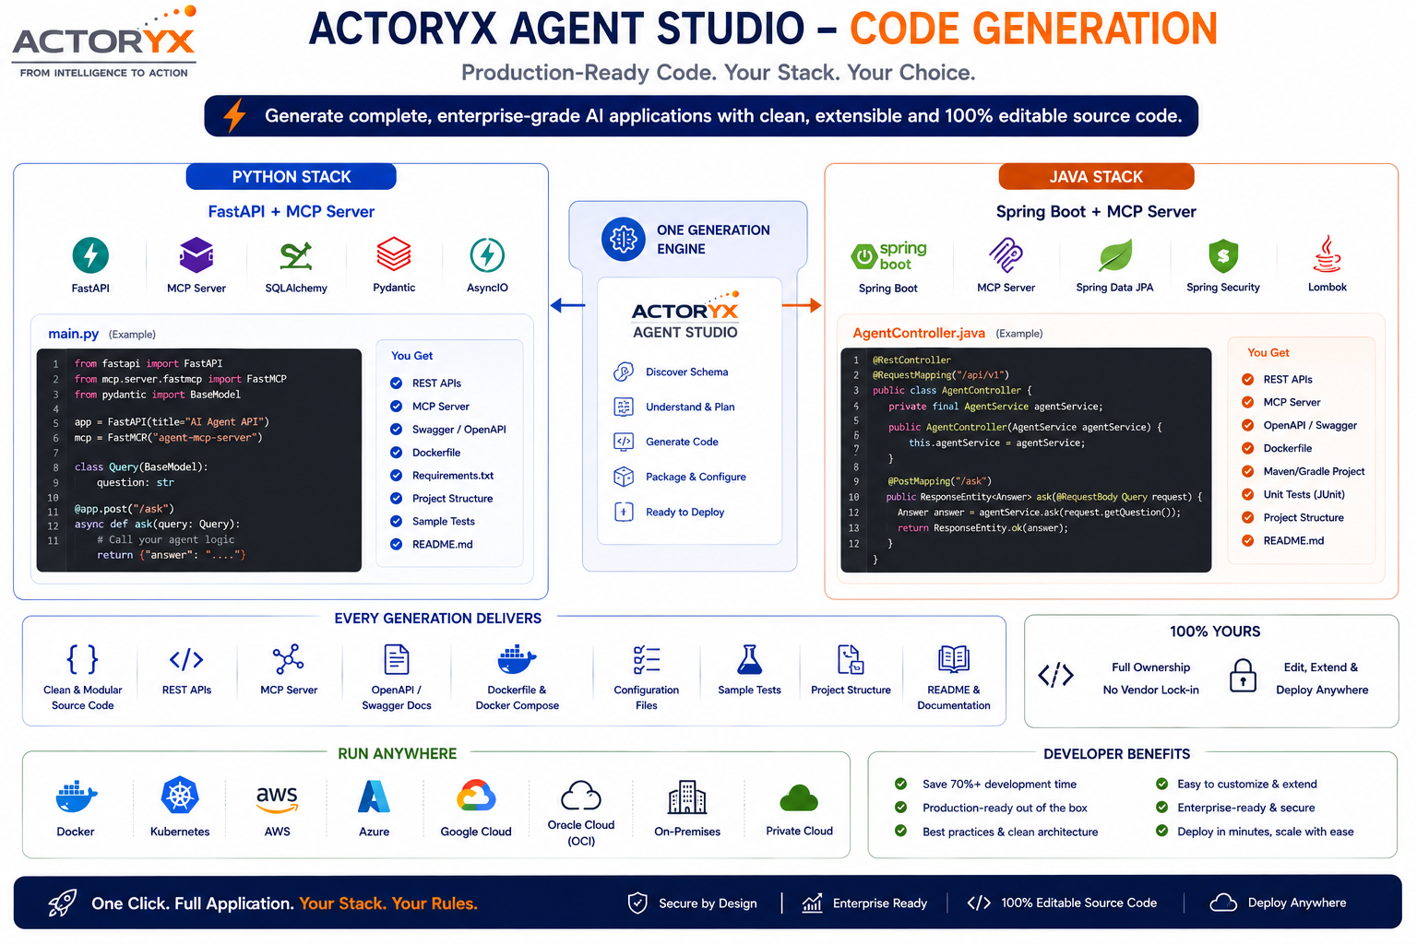
12

Slide 13
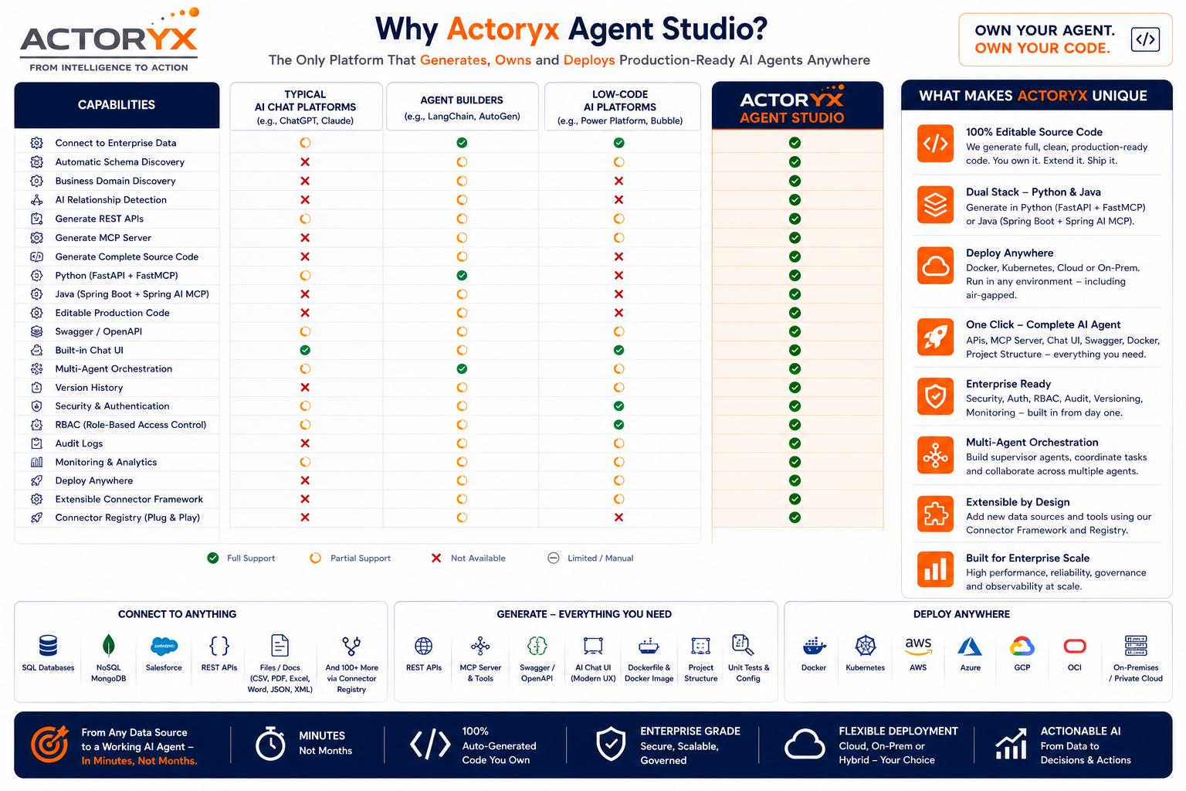
13

Slide 14
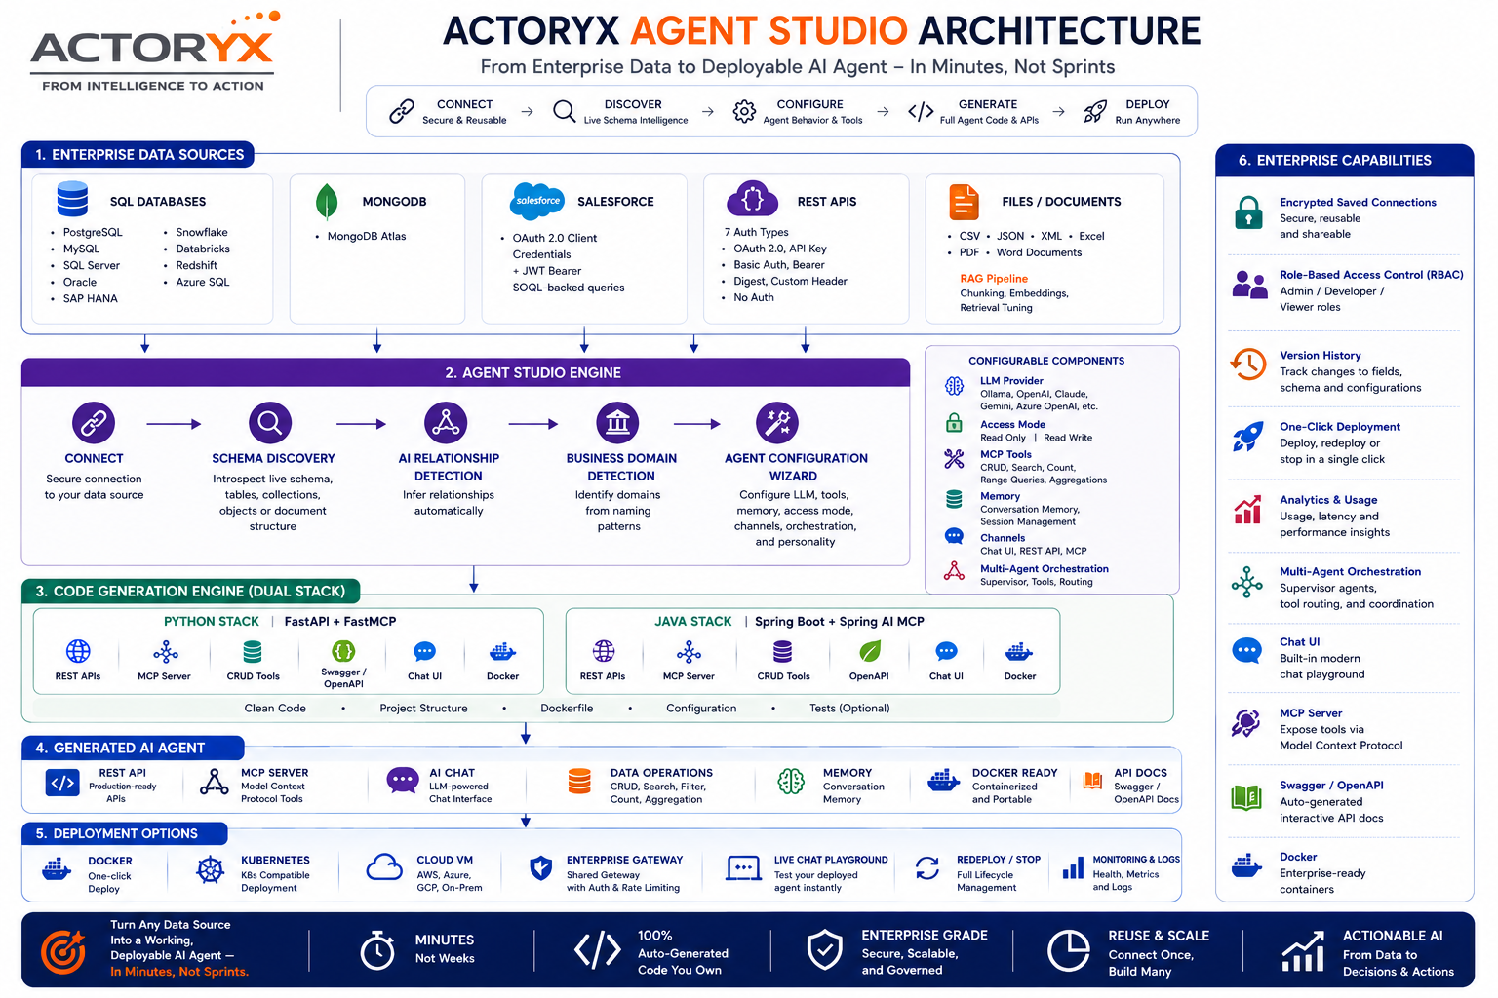
14

Slide 15
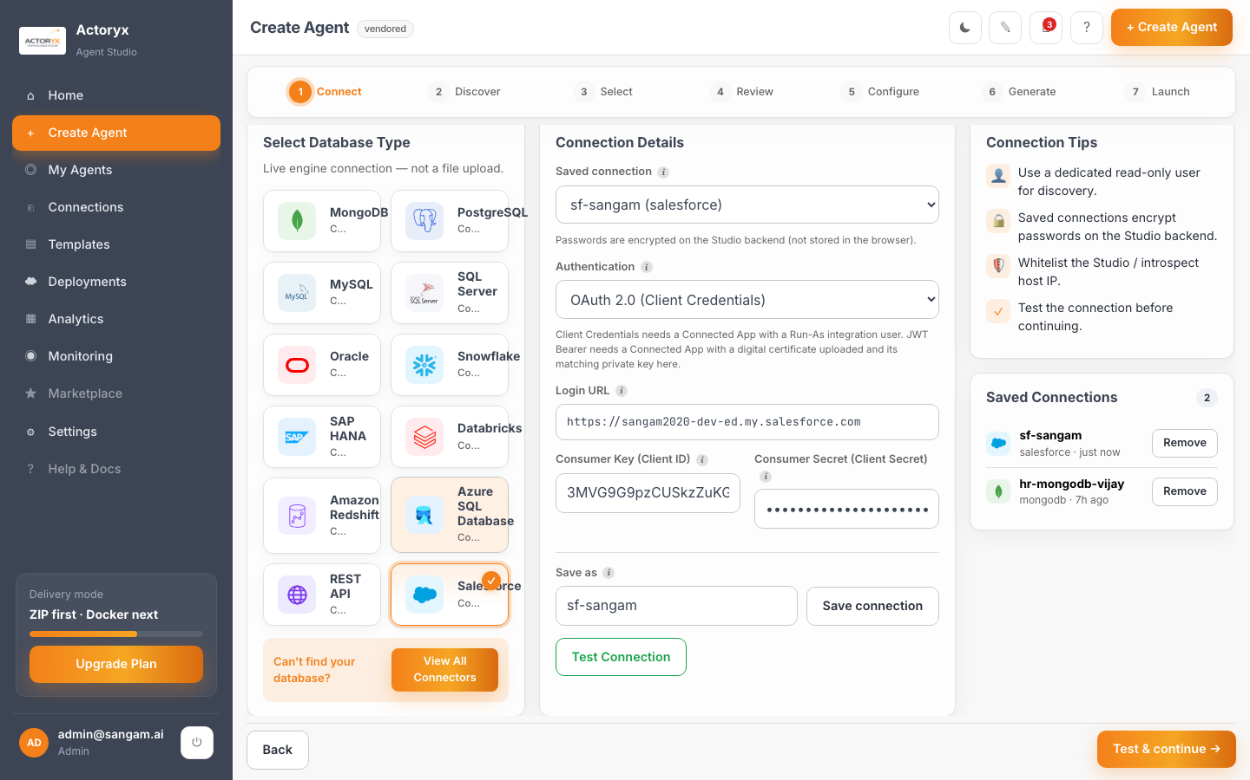
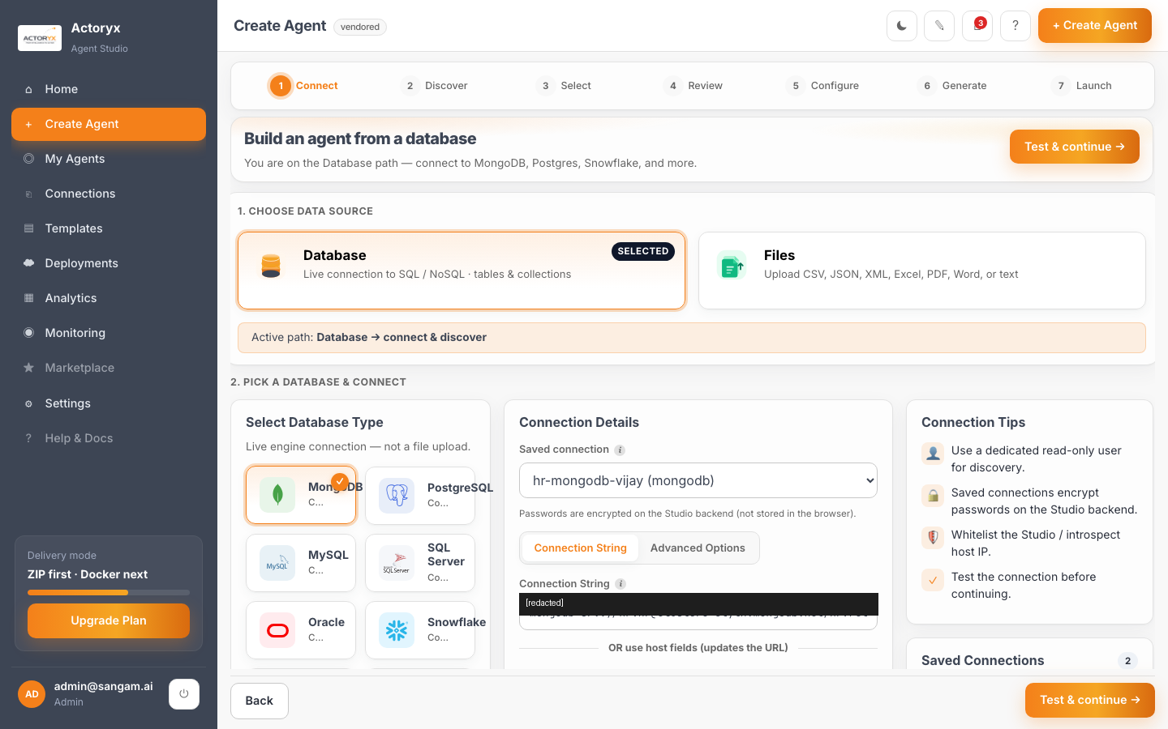
SEE IT IN ACTION — 01 CONNECT
One saved connection, either data source — no credentials re-entered, no code written.
SALESFORCE
MONGODB
OAuth 2.0 Client Credentials — saved connection “sf-sangam”
Atlas SRV connection — saved connection “hr-mongodb-vijay”
SEE IT IN ACTION
15

Slide 16
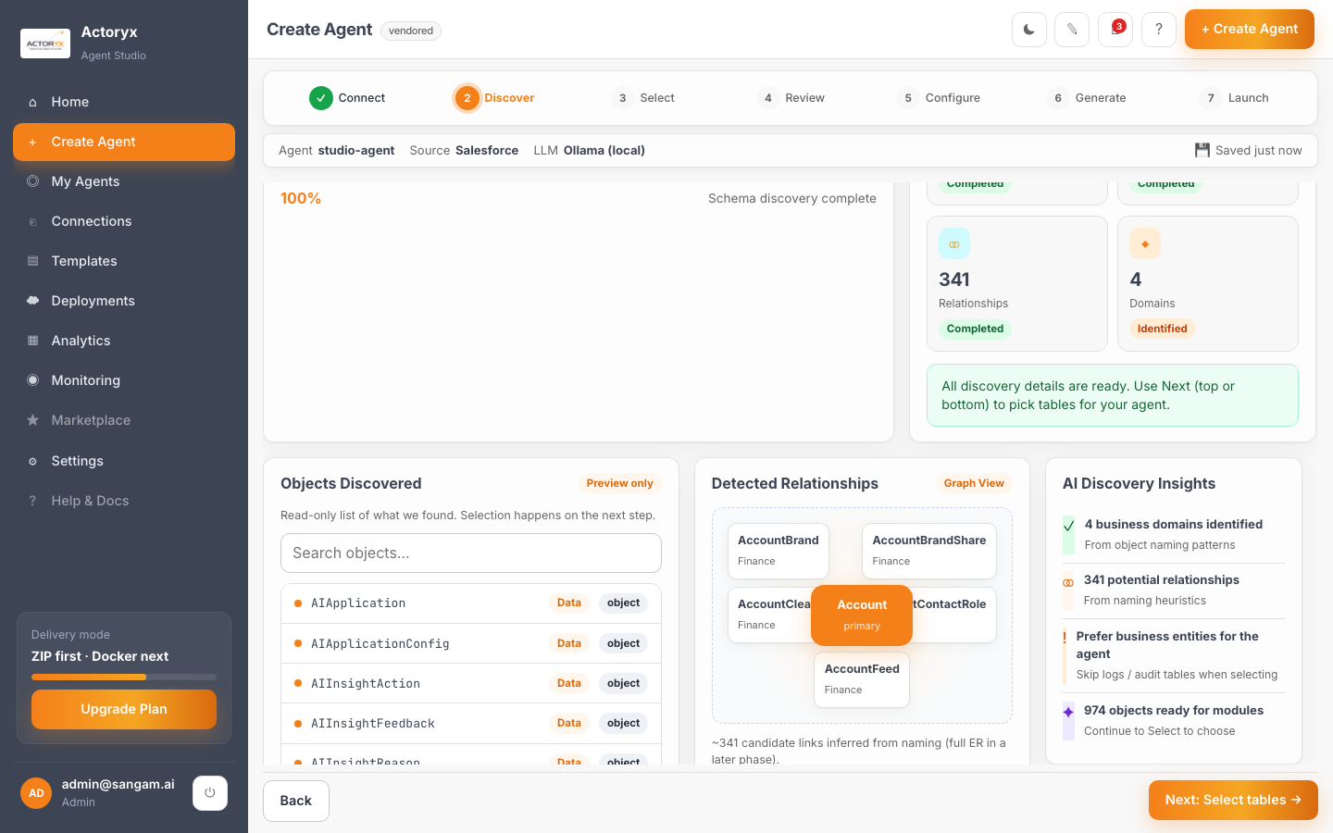
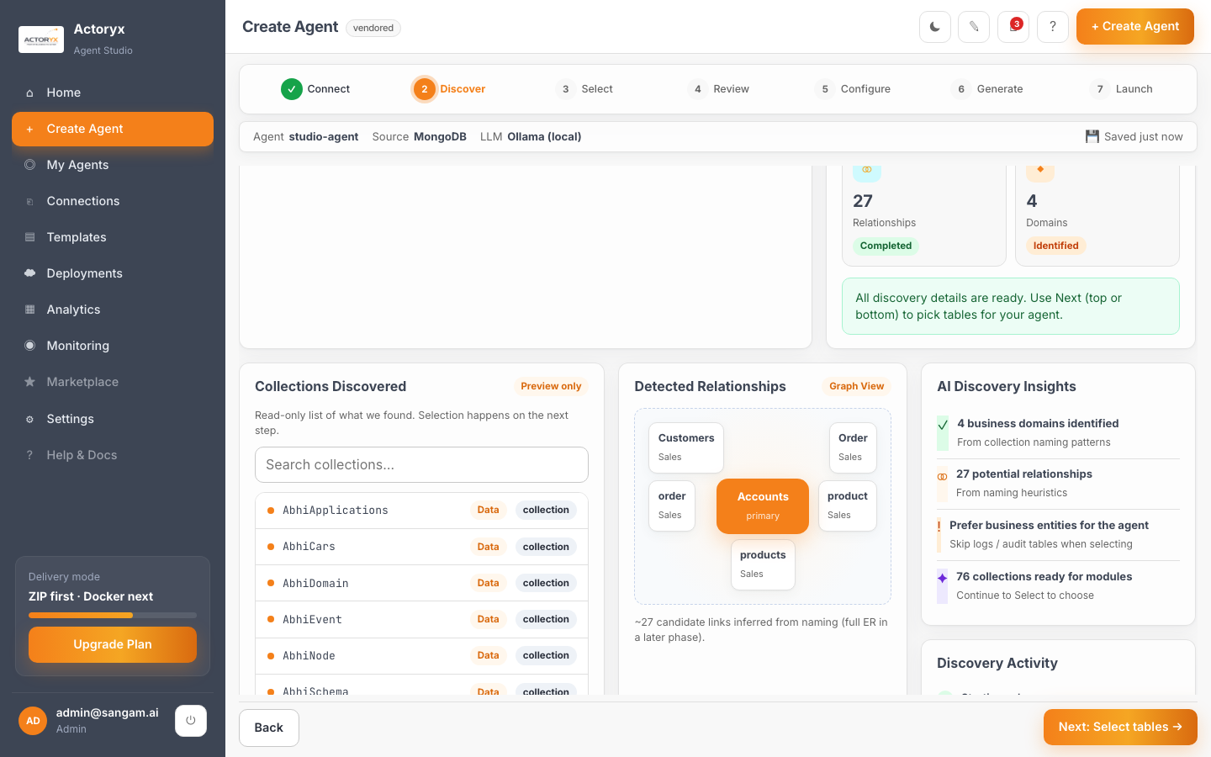
SEE IT IN ACTION — 02 DISCOVER
Real schema, introspected live — not a manual mapping step.
SALESFORCE
MONGODB
974 objects · 11,688 fields · 341 relationships found live
76 collections · 27 relationships found live
SEE IT IN ACTION
16

Slide 17
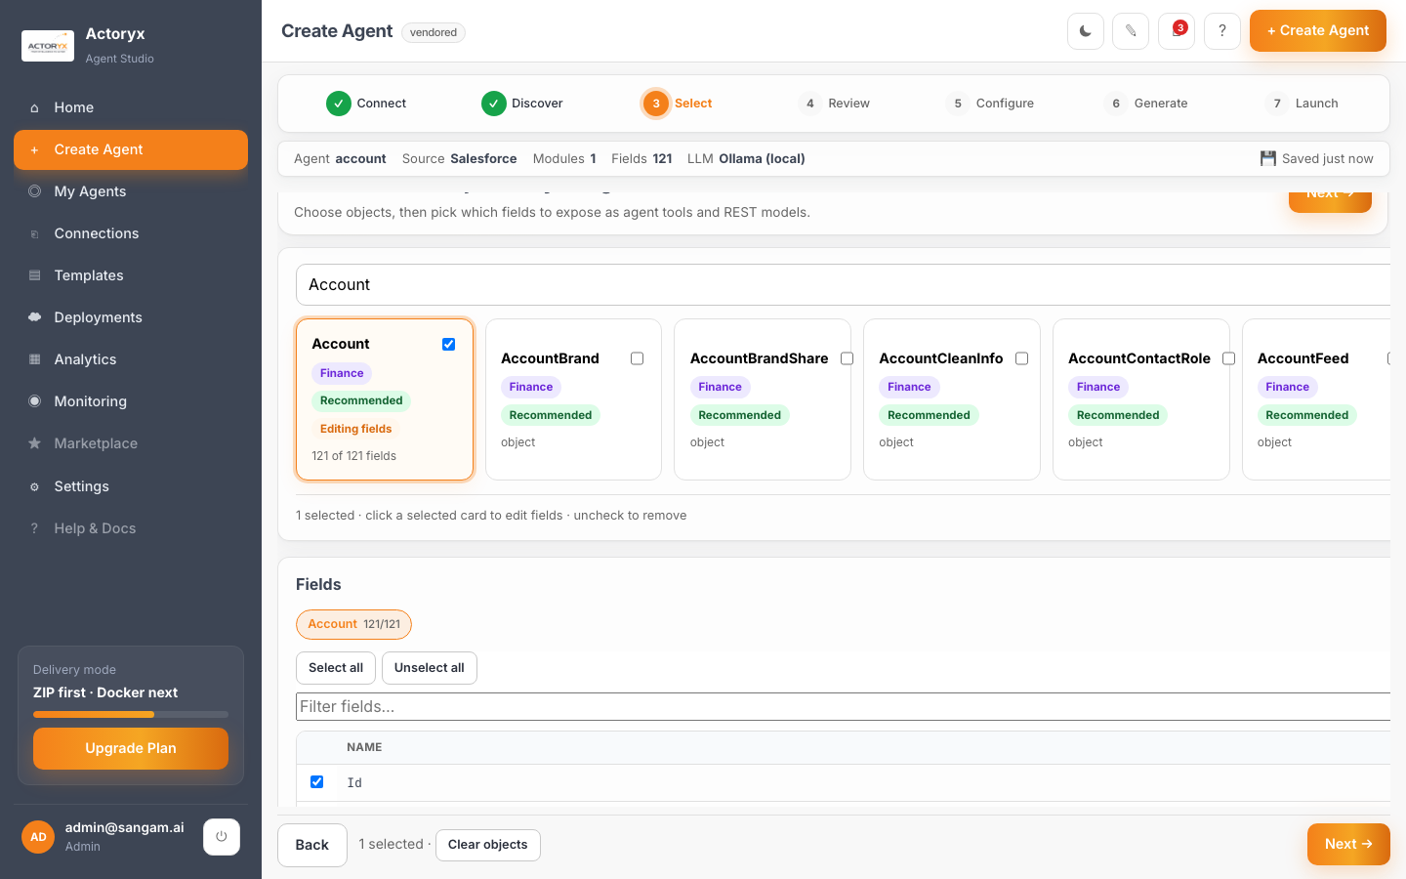
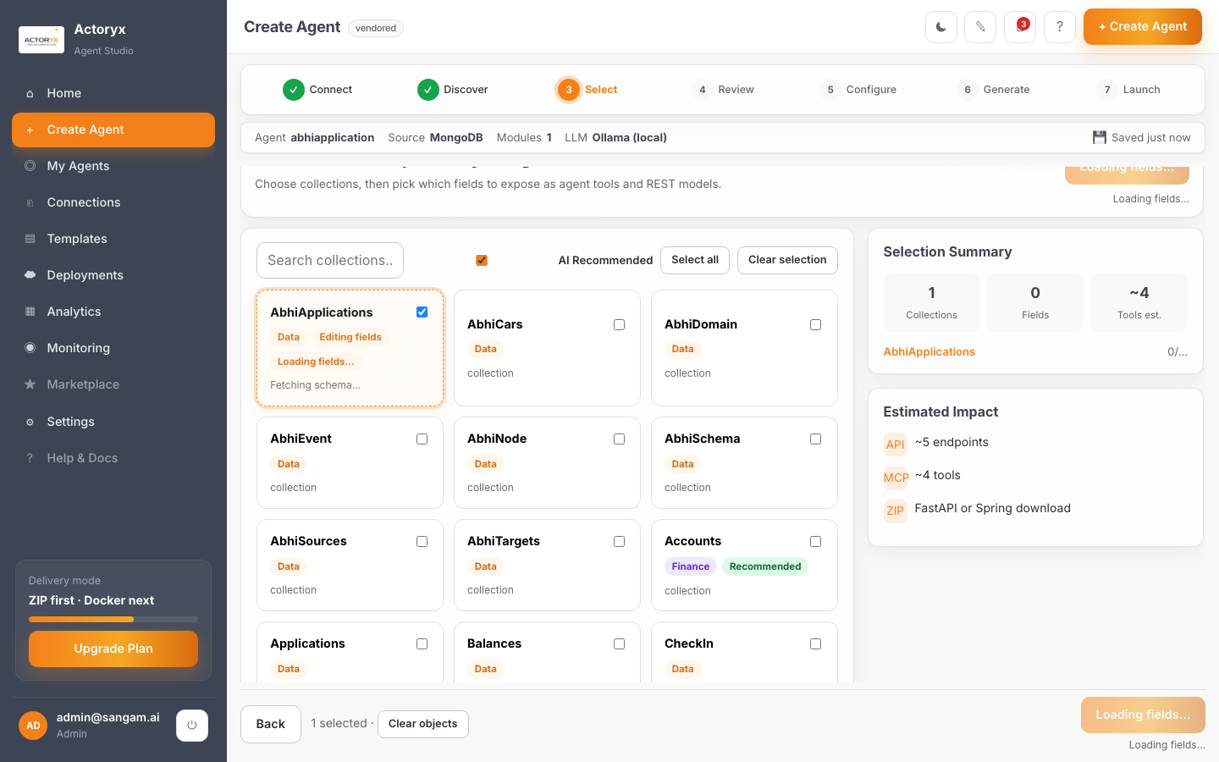
SEE IT IN ACTION — 03 SELECT
Field-level control over what the agent can see and do, either shape of data.
SALESFORCE
MONGODB
Account object — 121 fields selected
AbhiApplications collection selected
SEE IT IN ACTION
17

Slide 18
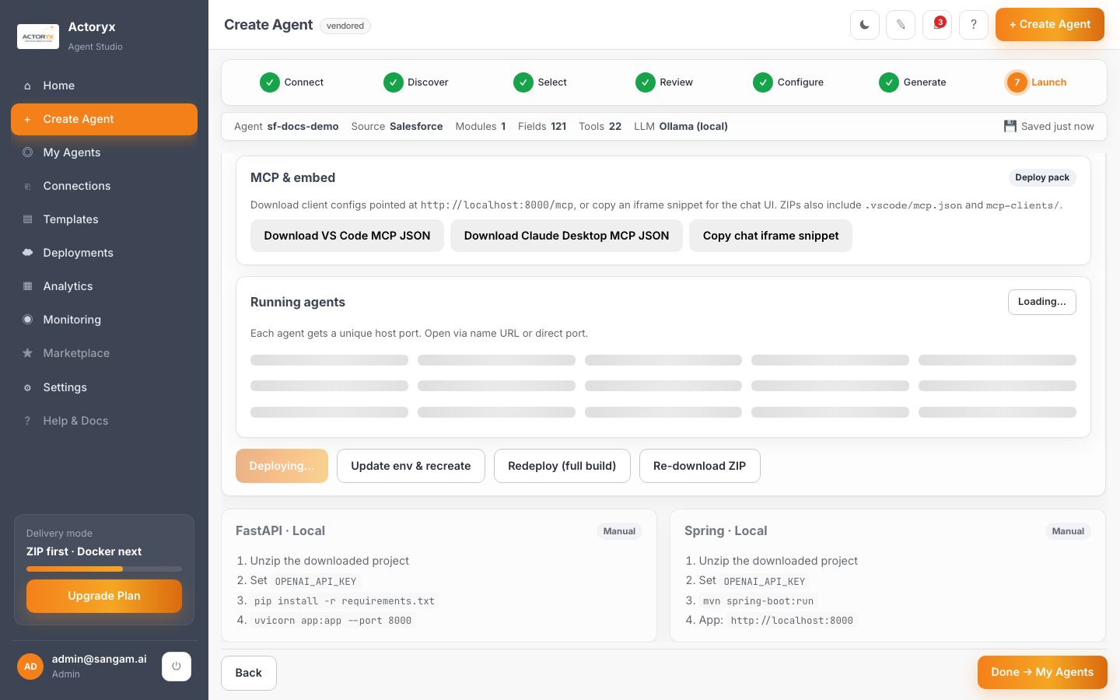

SEE IT IN ACTION — 04 DEPLOY
One-click Docker deploy, either backend — running behind a shared gateway in seconds.
SALESFORCE
MONGODB
sf-docs-demo — running on sf-docs-demo.localhost:8088
hr-docs-demo — running on hr-docs-demo.localhost:8088
SEE IT IN ACTION
18

Slide 19
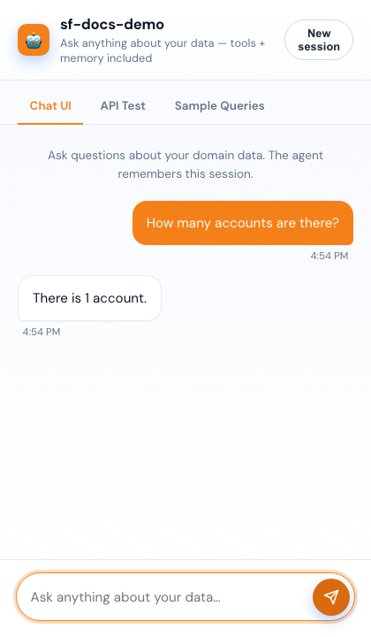
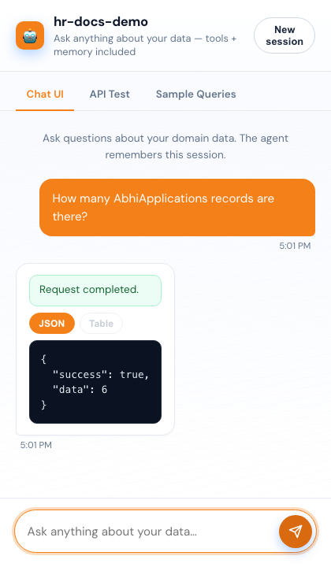
SEE IT IN ACTION — 05 CHAT RESULT
Real answers, from real data — the agent calling its own generated tools.
SALESFORCE
MONGODB
“How many accounts are there?” → “There is 1 account.”
“How many AbhiApplications records?” → 6 records
SEE IT IN ACTION
19

Slide 20
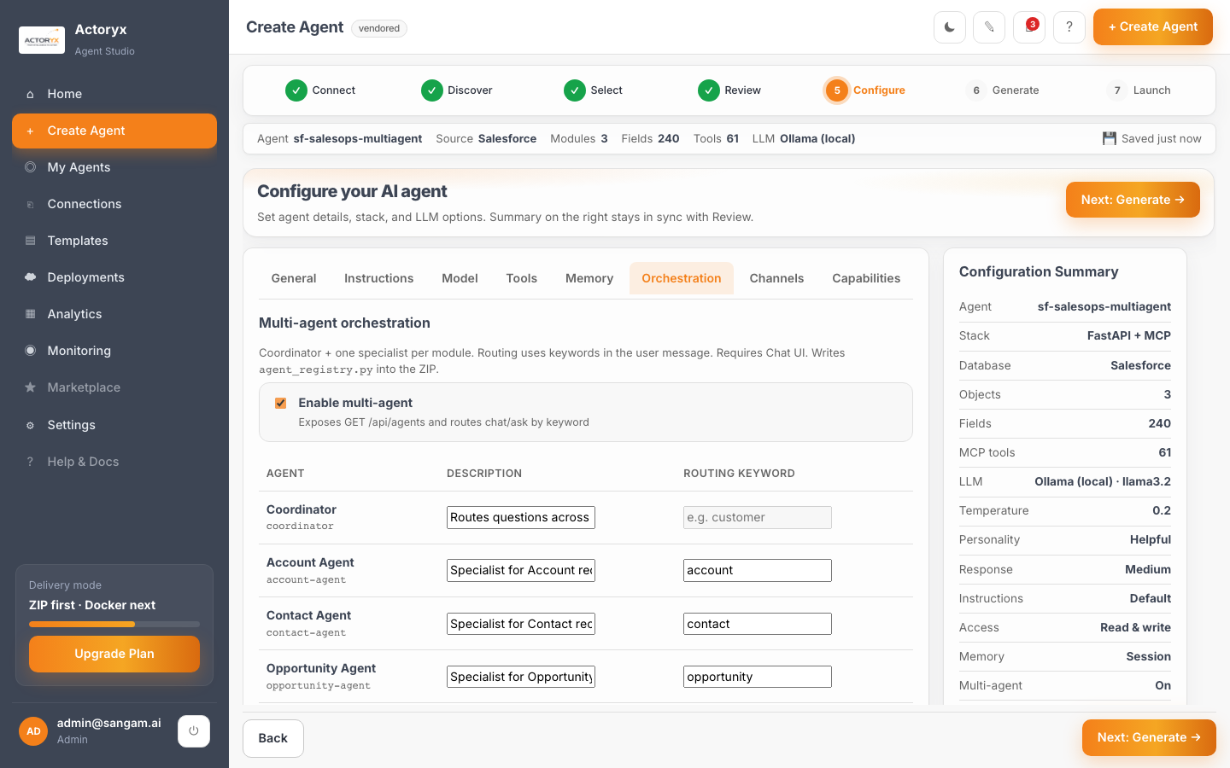

SEE IT IN ACTION — 06 MULTI-AGENT ROUTING
Select more than one object, flip one switch — Studio auto-generates a Coordinator plus one specialist per object, keyword-routed. Same mechanism, either data source.
SALESFORCE
MONGODB
Account + Contact + Opportunity → Coordinator + 3 specialists, auto-generated
Customers + Order + products → Coordinator + 3 specialists, auto-generated
SEE IT IN ACTION
20

Slide 21
FROM INTELLIGENCE
TO ACTION.
Let's connect your data, discover its structure, and deploy a working AI agent — this week, not next quarter.
www.actoryx.ai
Vijay.reddy@actoryx.ai

